Slide 1



MODULE 1 FINAL PROJECT : THE GAME
Frédéric Chhean

Slide 2


Who I am ?
Frédéric Chhean
Background
Why Ironhack ?

Slide 3

Problem identified
From cold conversation & small talks…

Slide 4

Opportunity: Break the ice
To fun & friendships

Slide 5

?
THE GAME

Slide 6

THE GAME: SECRET FACTS
Let's play

Slide 7
Technical Challenges
… TOO MUCH THINGS TO HANDLE …
HTML
CSS
Javascript
DOM tree
Selectors
Functions
Block vs Inline
Style
Array
Tag
Positioning
Objects
..... And many things more
..... And many things more
..... And many things more

Slide 8

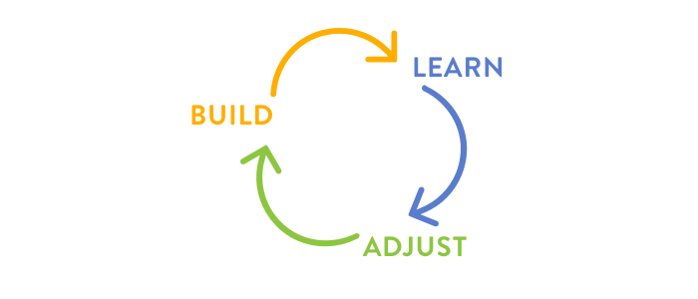
How to break the code ?
How to feed my mind well with all the concepts and mix everything ?

Slide 9

Biggest Mistakes
NOT thinking the global overview and the full user journey before acting

Slide 10
Product Road Map
Working with UX / UI Designer and experienced Developers to enhance the product
Deployment to users
2019
2020
S2
S3
S4
S1
MVP and Testing
Presentation and sell it
to Facebook

Slide 11

Thank you and Let’s play !

